Slide 1
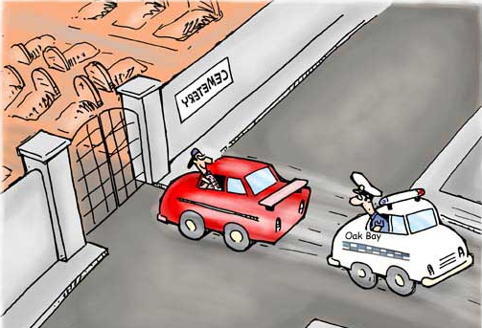
Cancer
Lesson 4.4
How does the immune system protect us from cancer?
Police
Notes:
This goes with the theme of cartoon images that the rest of the lessons have had and will be more evident to the kids than the previous image.

Slide 2
Do Now
We’ve used the analogy of a cancer cell being a renegade in the community of cells. What in the body is acting as the police?

Slide 3
Do Now
What is the function of our immune system?
What does the immune system recognize as a
threat that needs destroying?
Pathogens
Damaged cells and tissue
Tumor cells
Some transplanted tissues

Slide 4
The immune system distinguishes ‘self’ from ‘non-self’ and ‘abnormal-self’
Self: Our normal cells and tissues
Non-self: Anything not our normal cells and tissues
Abnormal self: Our normal cells and tissues that have changed in some way.

Slide 5
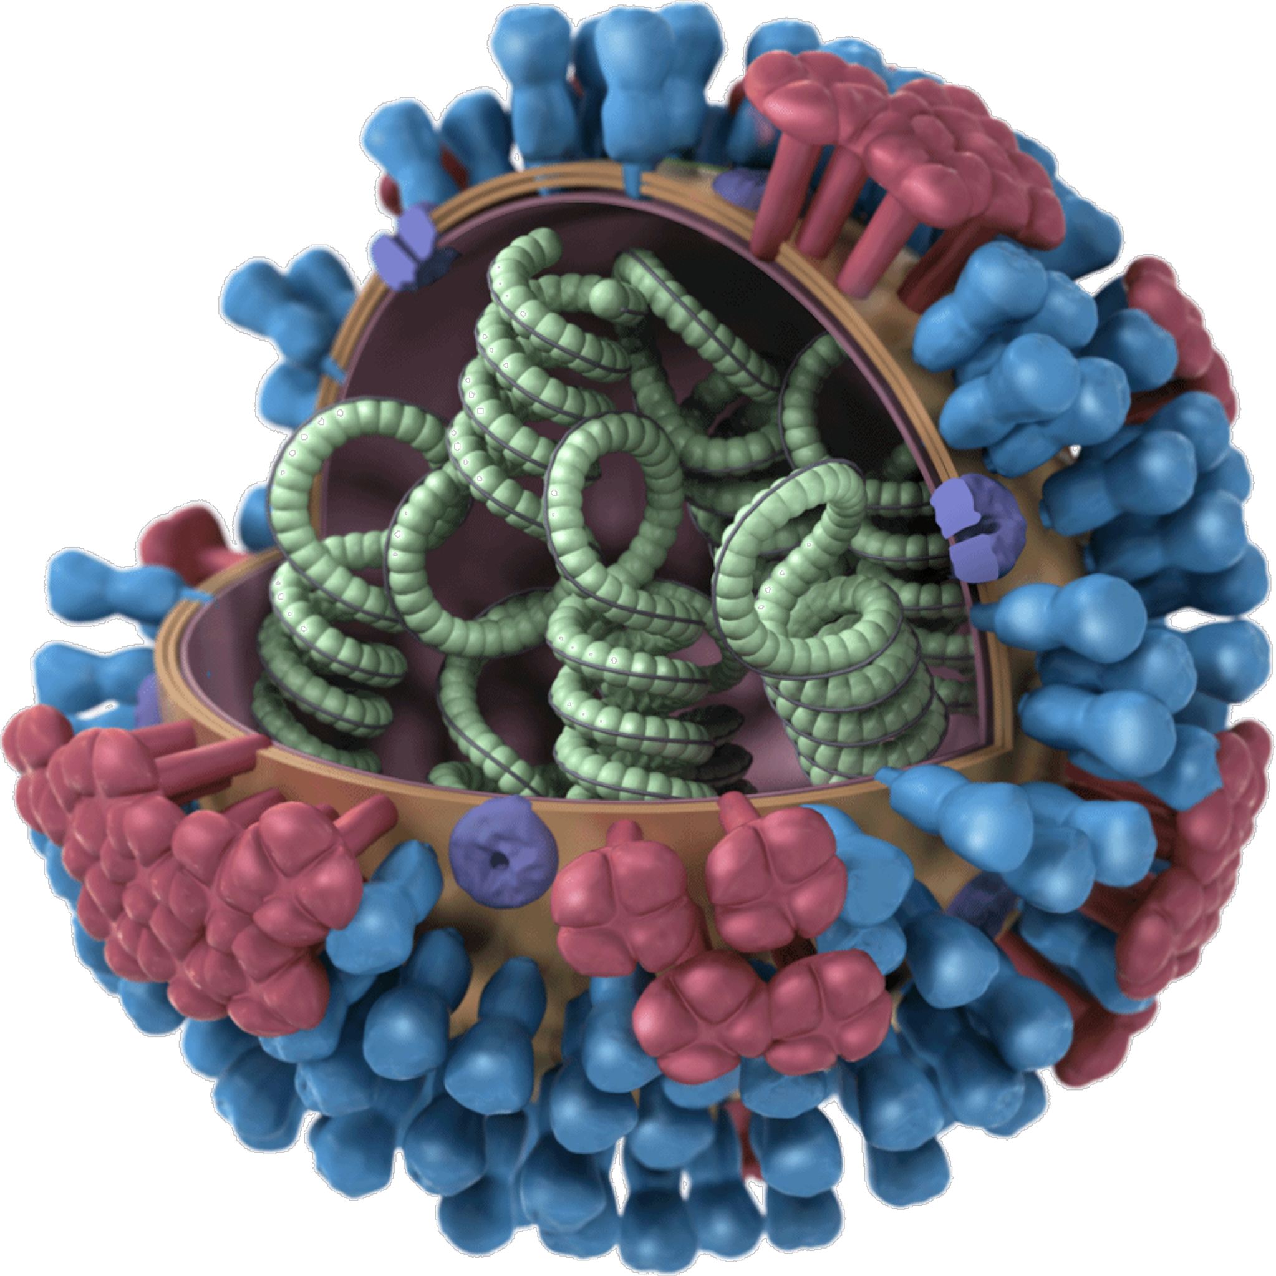
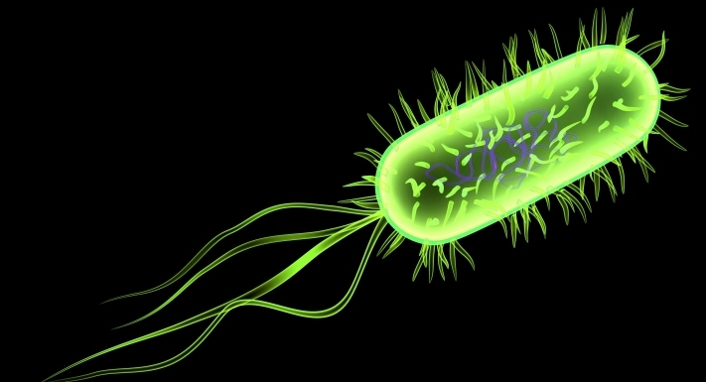
How does the immune system recognize pathogens as non-self?
Bacterial structures
Virus structures

Slide 6
How can normal cells become ‘abnormal-self?
T
T
T
Proteins are mutated

Slide 7
How can normal cells become ‘abnormal-self?
t
t
t
t
t
t
Proteins are expressed when they shouldn’t be

Slide 8
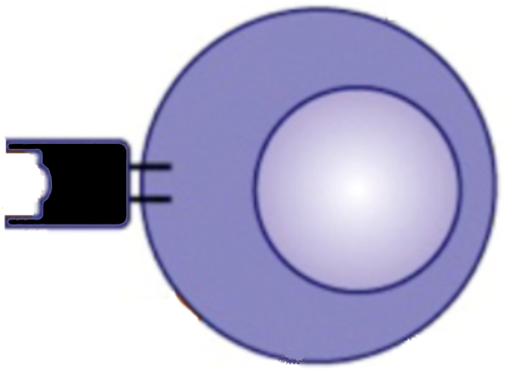
Killer T-cells recognize fragments of abnormal-self proteins
I
C
I
t
t
t
C
I
I
t
t
t
C
C
C
I
= MHC-1
The killer T cell attacks the tumor cell

Slide 9
Then killer T-cells destroy the cancer cell
I
t
t
t
C
I
I
t
t
t
C
C
I

Slide 10
The population of T cells expands
I
t
t
t
C
I
I
t
t
t
C
C
I

Slide 11
More cancer cells can be destroyed
I
t
t
t
C
I
t
I
t
t
C
I
t
t
I
t
I
t
t
t
C
C
C
I
t
C
I
I
t
t
C
I
I
t
t
t
C
C
I
Notes:
Eg: proto-oncogenes

Slide 12
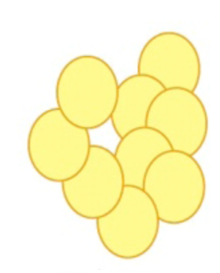
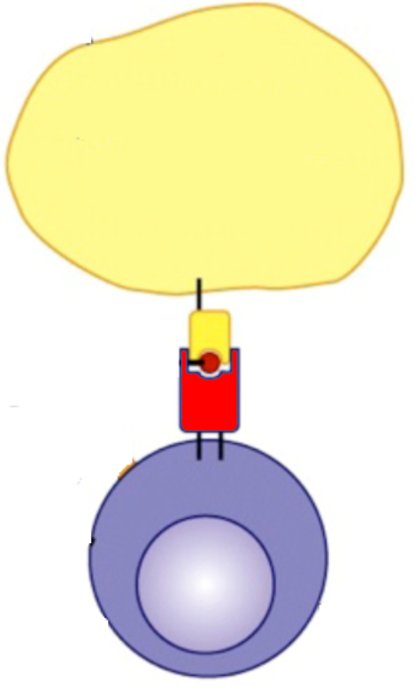
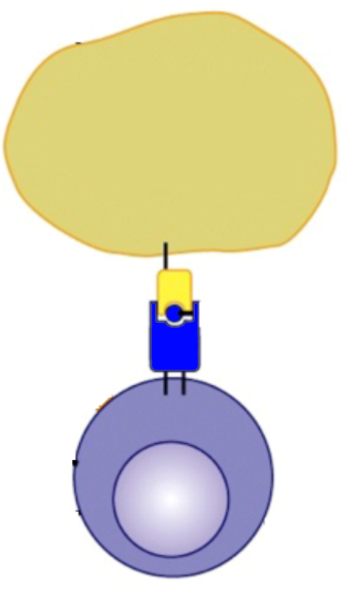
Melanoma!
Early metastasis
Late metastasis
5 years
6 years
5 years
Patient dies!
Primary tumor removed
Tumor expresses
MART-1 and
Tyrosinase
Tyrosinase
Tumor expresses
Tumor only presents
MART-1 on the surface
Now the tumor
presents tyrosinase
Tumor is killed by
Killer T cells that recognize
MART-1 as non-self
Tumor is killed by
Killer T cells that recognize
Tyrosinase as non-self

Slide 13
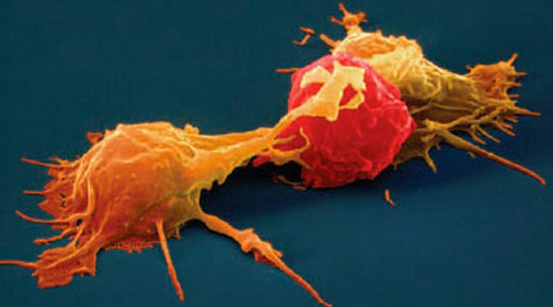
The natural killer cell is also on the team!
Natural killer cells use MHC-1 differently than
killer T cells

Slide 14
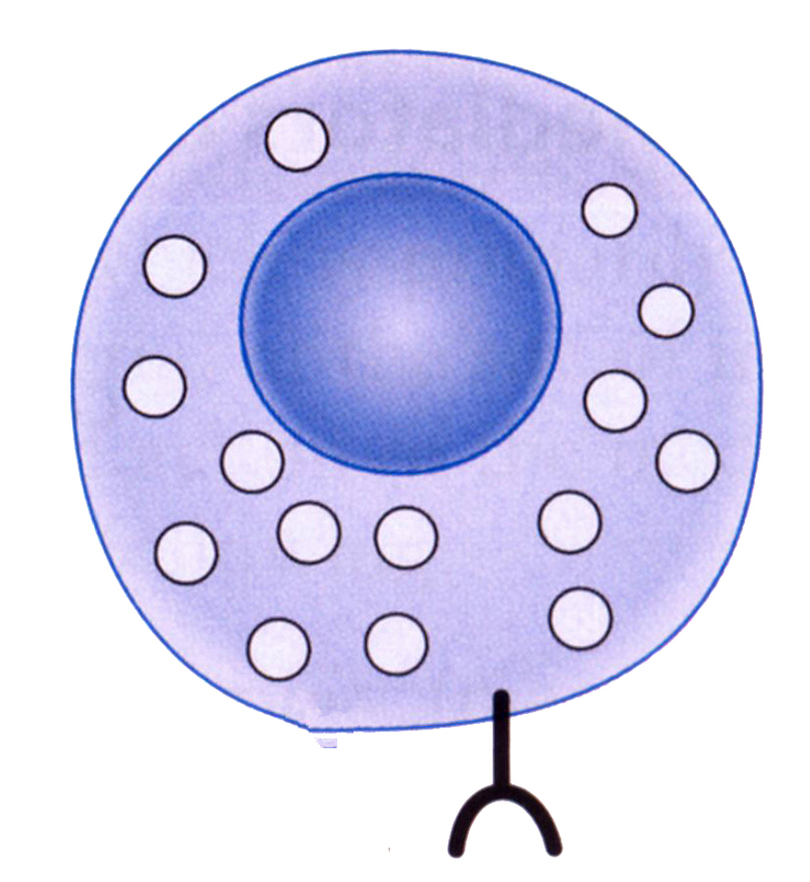
Natural killer cells also have receptors that recognize MHC-1
Inhibitory receptor

Slide 15
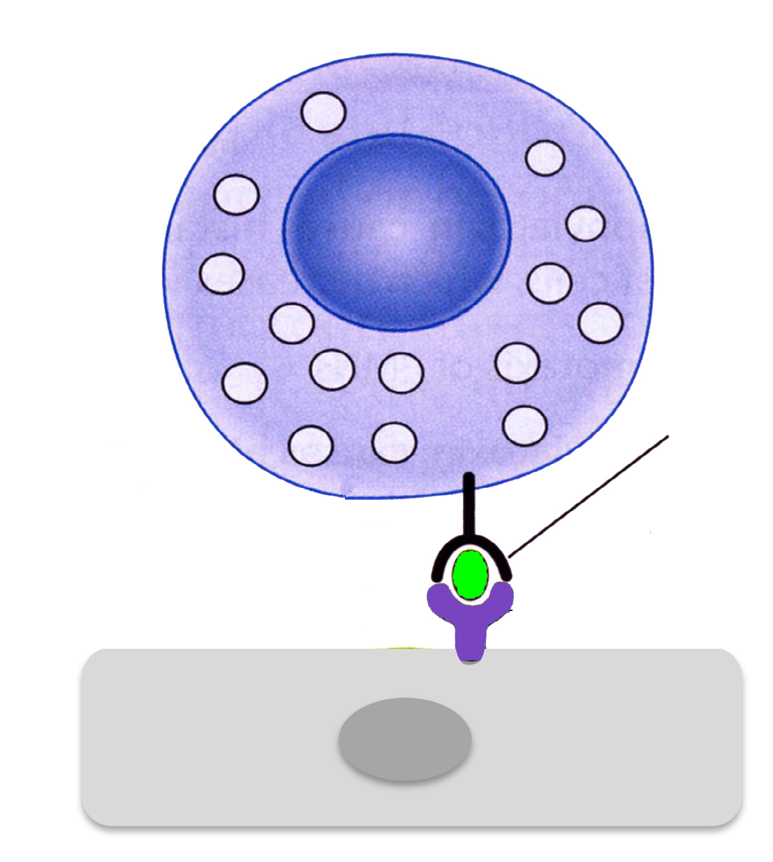
As long as the inhibitory receptor is attached to MHC-1 the cell is safe
Inhibitory receptor
Self antigen
MHC-1
Normal cell

Slide 16
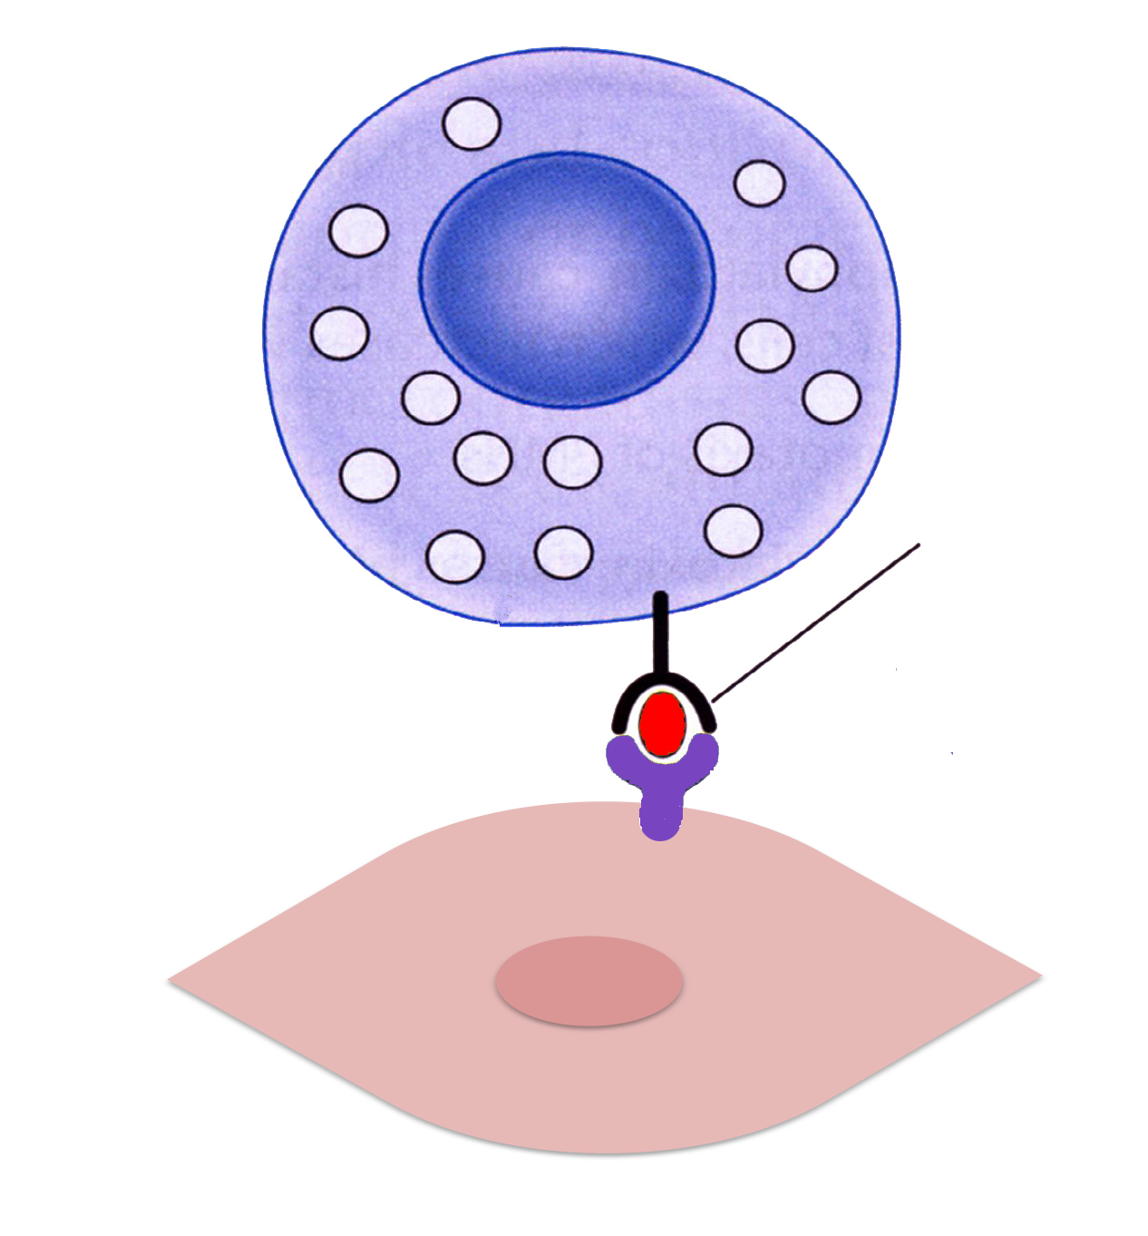
This is true whether MHC-1 is presenting ‘self’ or ‘abnormal-self’ antigens
Inhibitory receptor
Abnormal self antigen
Tumor cell
As long as MHC-1 is engaged the cell is not killed!
Notes:
.

Slide 17
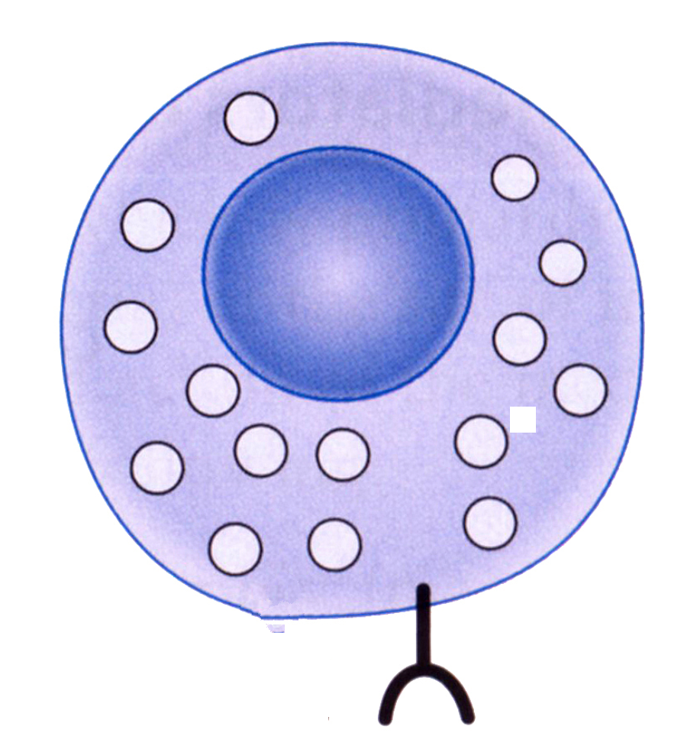
Tumor cells that are growing rapidly often stop making MHC-1
Inhibitory receptor cannot engage!
tumor cell
No more MHC-1 on the tumor
cell surface!
Now the natural killer cell can’t attach to MHC-1 and kills the tumor cell!

Slide 18
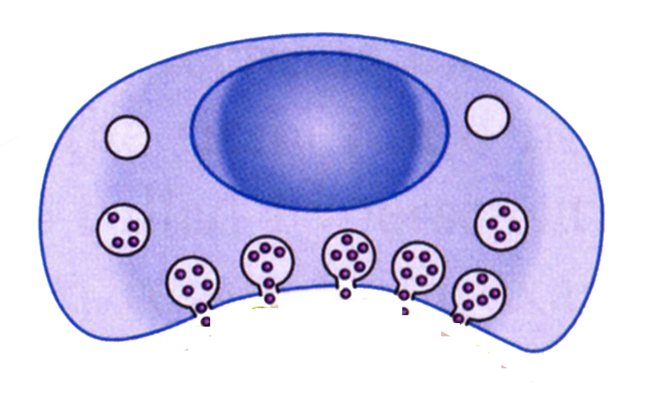
Killer T cells and Natural Killer cells kill 99% of all tumor cells

Slide 19
Activity
Use this information to calculate the time frame in which an epithelial cell could become cancerous
How often does the cell duplicate? | Every 3 days
How many mutations accumulate at each duplication? | 175
How many mutations does the cell accumulate a year? | 22,000
How many bases are there in the human genome? | 6.4 billion
How many of these bases code for genes? | 2%
What proportion of the genes are oncogenes? | 0.1%
Total number of cells in the adult human body | 1 x 10¹⁴

Slide 20
What’s the time line for a cell to transform?
Time (in years) = Genome size x fraction that is oncogenes Yearly mutation rate x cells in body
= [6.4 x 10⁹] x 0.00002
22,000 x 10¹⁴
5.8 x 10⁻¹⁴ years/mutation

Slide 21
How many seconds per mutation? Convert the number of years into seconds:
= 5.8 x 10⁻¹⁴ (years/mutation) x 365 (days/year) x 24 (hrs/day) x 3600 (secs/hr)
1 mutation = 1.8 x 10⁻⁶ seconds

Slide 22
Assuming 3 mutations are necessary for transformation, how many seconds would it take to transform a cell?
= 1.8 x 10⁻⁶ seconds/mutation x 3
Approximately 5 x 10⁻⁶ seconds/cell
One cell is transformed each 5 millionth of a second!

Slide 23
So…. How many cells get transformed each second?
One cell each 5 millionth of a second
5 x 10⁻⁶ seconds = 1 cell
1 second = 1 cells
5 x 10⁻⁶
= 10⁶ cells
5
Approximately 200,000 cells per second!

Slide 24
Wrap up: How does the immune system stop cancers?
Kills cells expressing non-self antigens.
Activates immune cells to seek out cancer cells.
Secretes antibodies/toxin/complement that kills cancer cells.
Promotes apoptosis in cancer cells.
Bosters stroma to prevent it signaling to promote cancer growth/migration

Slide 25
Wrap up: How do cancer cells evade the immune system?
Kills non-self cells.
Cancer cells inhibit expression of MHC-1 and decrease expression of cancer antigens.
Activates immune cells to seek out tumor cells.
Cancer cells activate apoptosis in immune cells.

Slide 26
Wrap up: How do cancer cells evade the immune system?
Promotes apoptosis in cancer cells.
Cancer cells mutate their own apoptosis mechanisms.
Secretes toxins/antibodies/complement that kills cancer cells.
Cancer cells secrete signals that prevent immune cells secreting toxins/antibodies/complement

Slide 27
Wrap up: How do cancer cells evade the immune system?
Bolsters stroma to prevent it signaling to promote cancer growth/migration
Cancer cells signal immune cells to degrade stroma. This activates inflammation and promotes cancer proliferation.

Slide 28
Wrap up: The immune system-Catch 22!
The immune system is essential in controlling tumors.
But an overactive immune system can lead to tumors.
Chronic conditions such as infection or obesity, can cause chronic inflammation.

Slide 29
The immune system – Catch 22!
Transplant patients must take drugs that inhibit the immune system to prevent organ rejection.
Steve Jobs died of a lung tumor 2 years after his liver transplant.

Slide 30
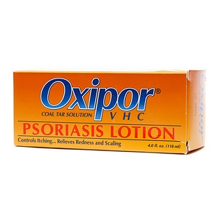
Carcinogens can be immunosuppressive!
Nicotine in tobacco is immunosuppressive
Coal tars and UVB radiation are used to treat psoriasis.

Slide 31
Homework
Read about how immunotherapy offers hope for new types of anti-cancer therapies.

